Slide 1
ENIAC
Discounts Strategy Evaluation
Fabio , Guy ,Santhoshi.

Slide 2

Key Considerations:
Do aggressive discounts create noticeable higher sales?
Is effectiveness of discounts correlated to specific product categories?
Is Revenue decreasing due to misplaced discount?
Does refined discount strategy can effectively drive increased revenue?

Slide 3
Total Orders
1,86021
Data considerations:
ENIAC’s dataset is convoluted, mismatched and corrupt.
Data cleaning:
Duplications
Empty values
Gross outliers
Unexplainable values
Completed Orders – 22.5%
2017-01-01 to 2018-03-14
98.2 %
Products Sold with Discount
Total Revenue
7817204 Euros
Products
9992

Slide 4
Data Considerations
Timeframe 2017 Q1, Q2, Q3, Q4
2018 Q1
Data processed
Only Completed Orders were considered
Price categories: Very Low <50€ Low <100€ Mid <200€ High <500€ Expensive >500€
Discount categories: Low <10% Mid <25% High <50% Aggressive >50%

Slide 5
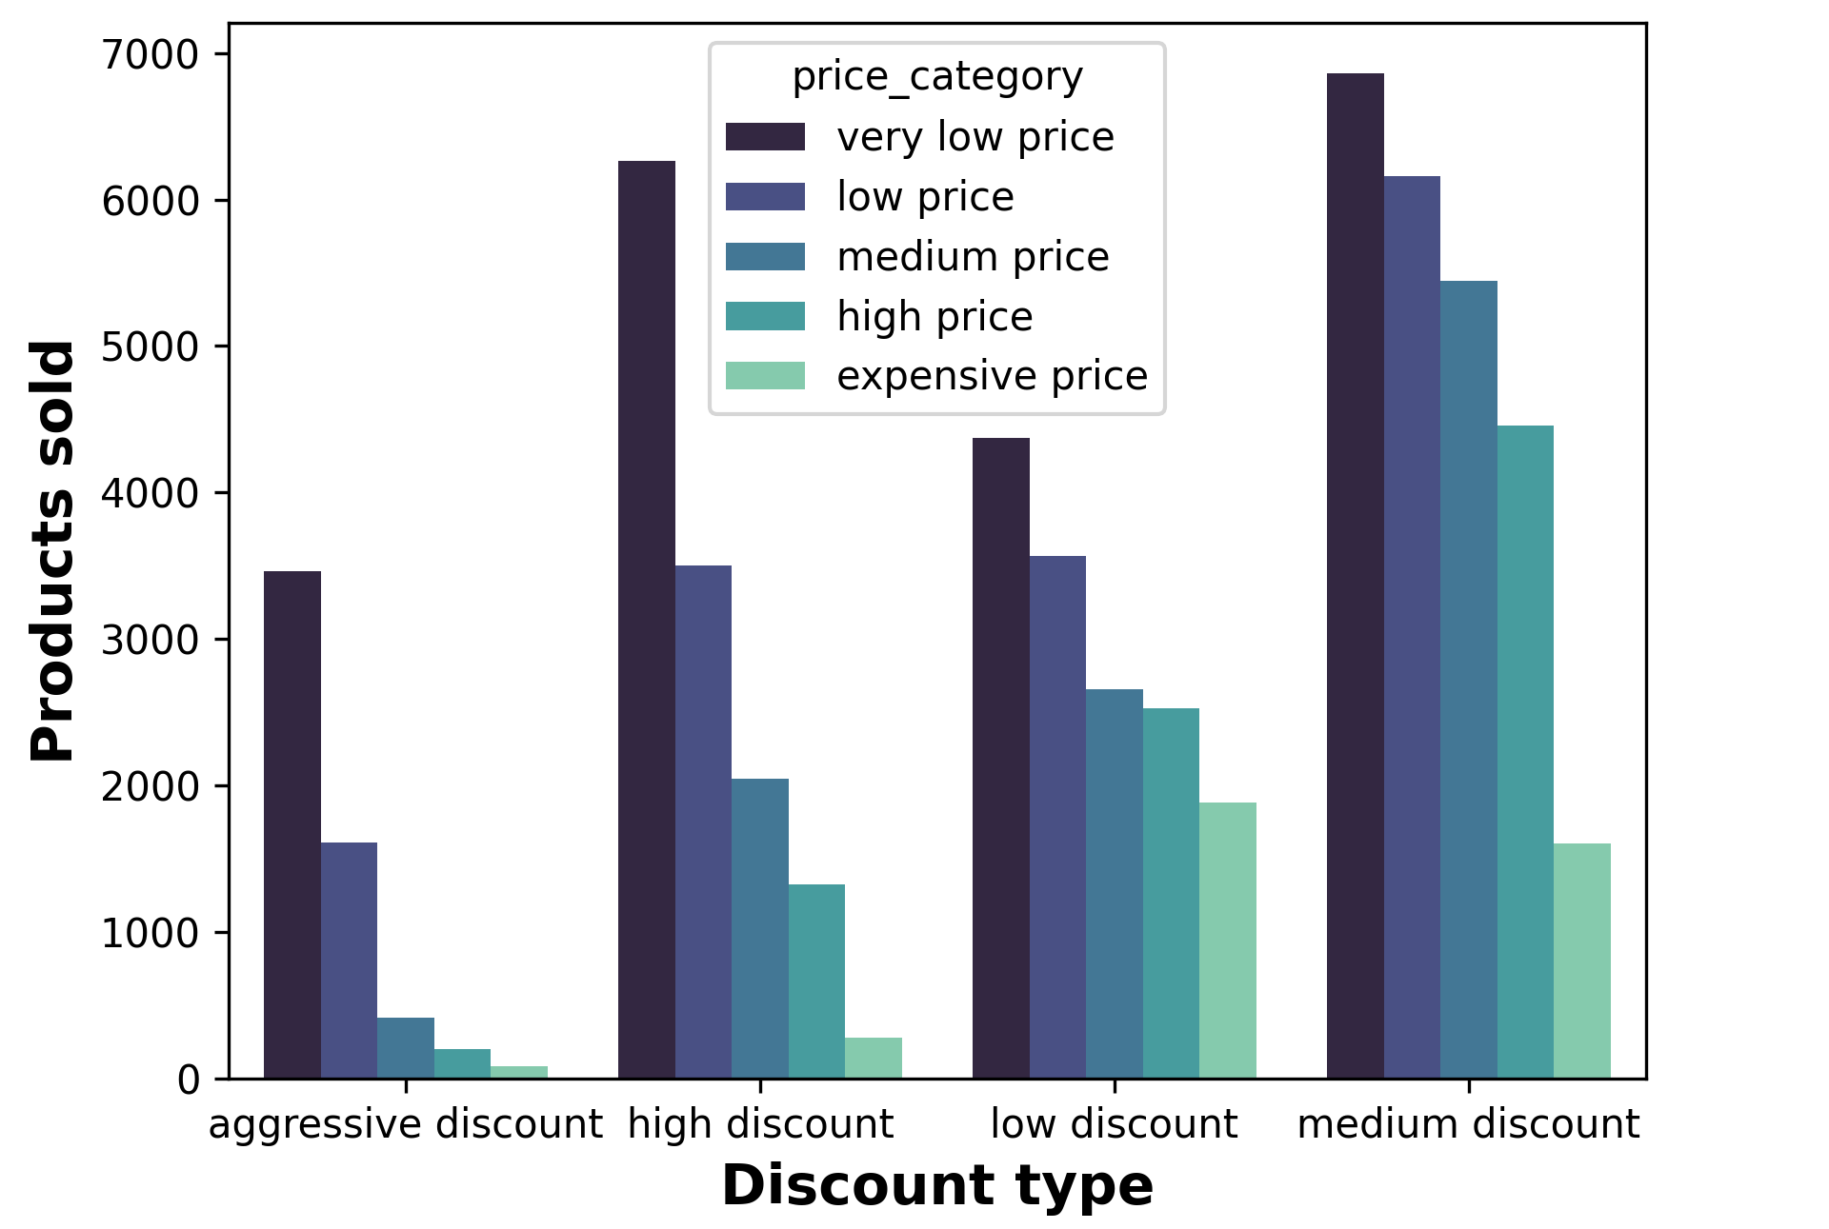
Aggressive discounts don’t work!
Across all price levels, Aggressive discounts actually hinder number of sales.
Medium to Low discounts seem to best induce product sales!

Slide 6
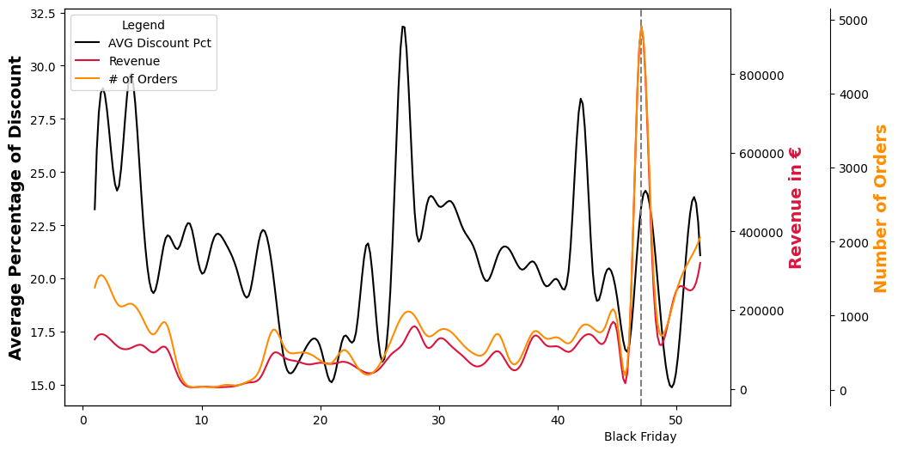
Yearly Overview (all products)

Slide 7
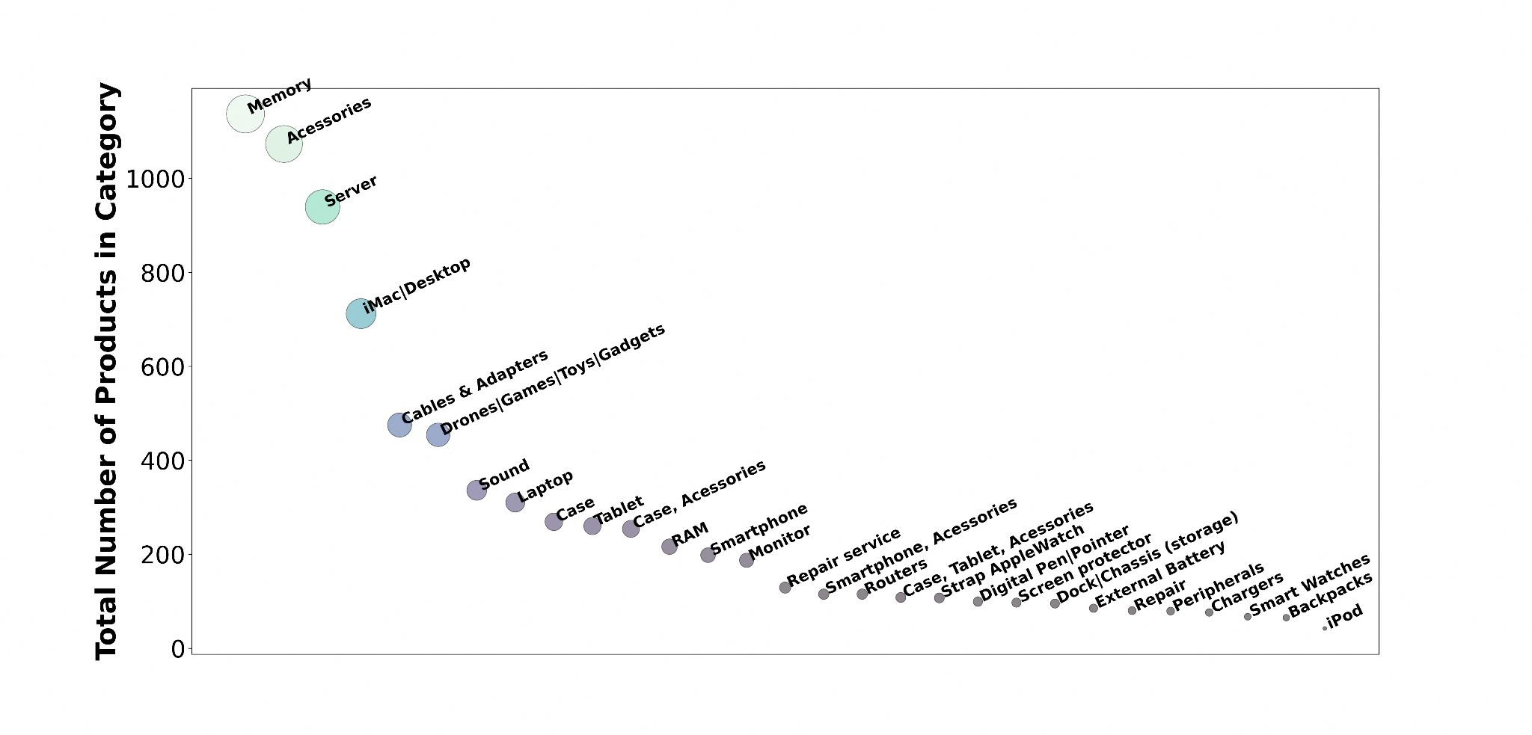
Eniac portfolio distribution by Categories
29 Categories

Slide 8
Eniac portfolio distribution by Categories

Slide 9
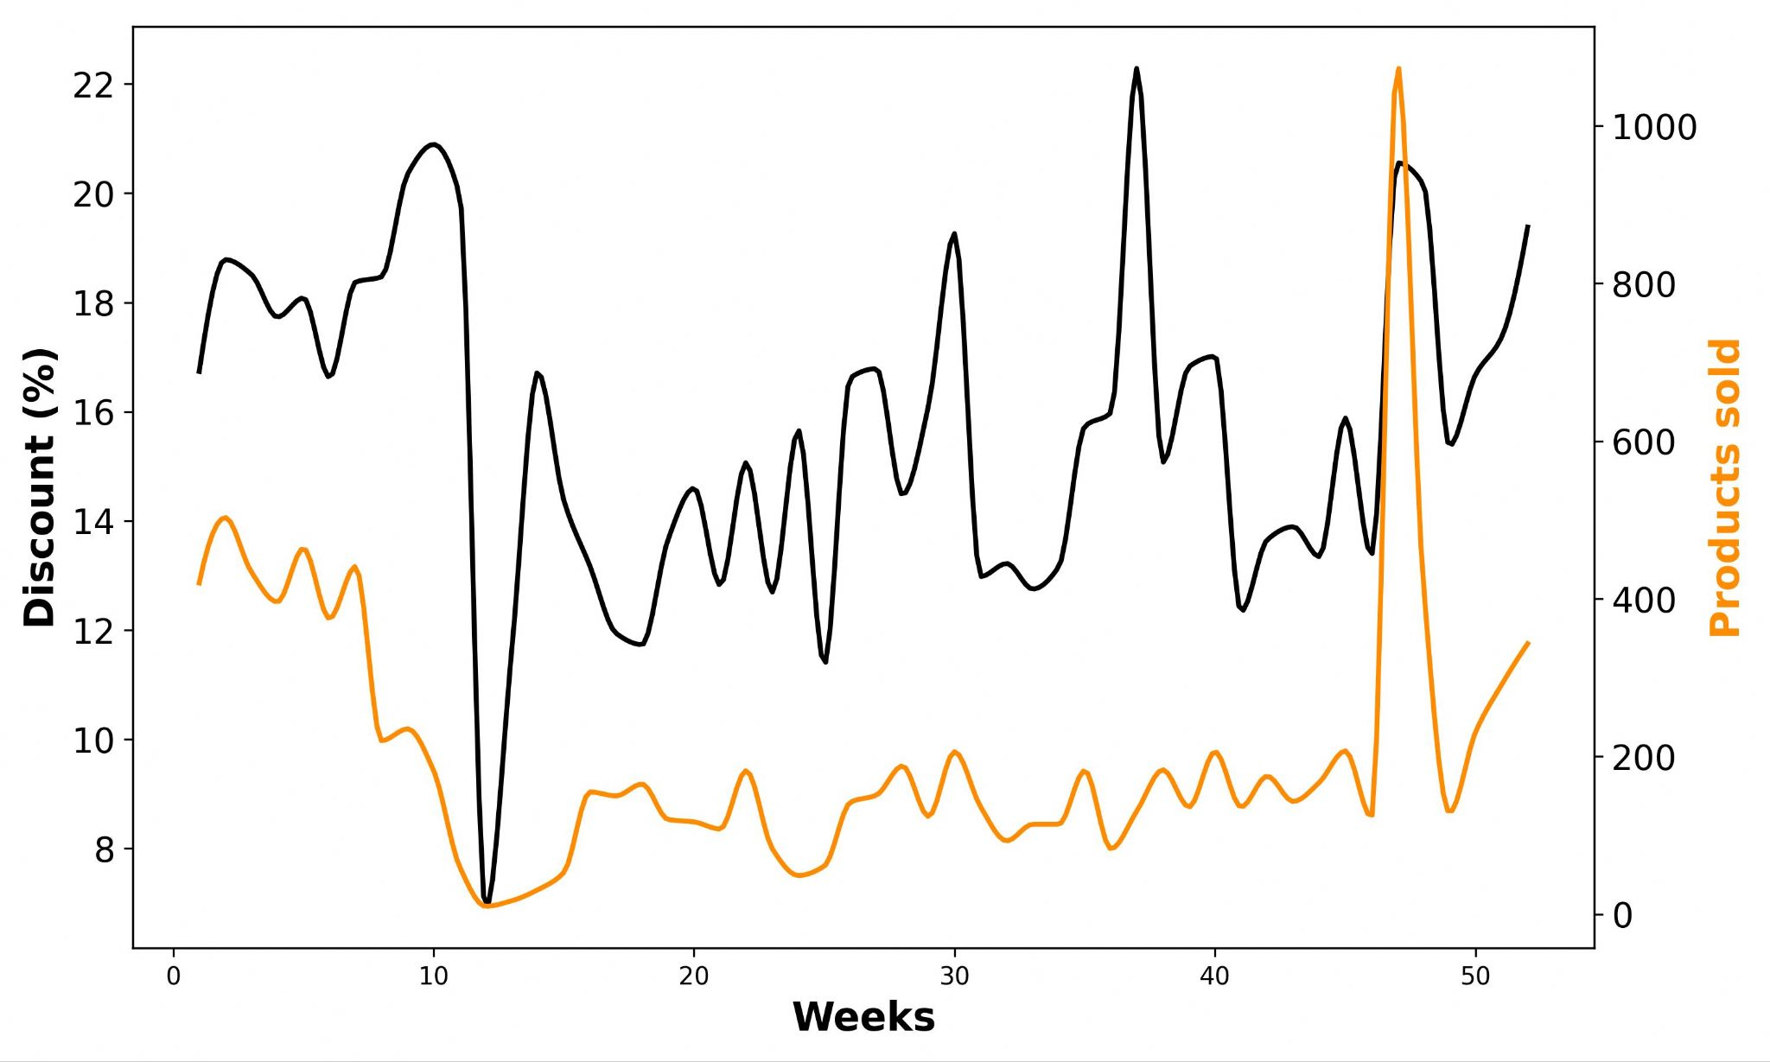
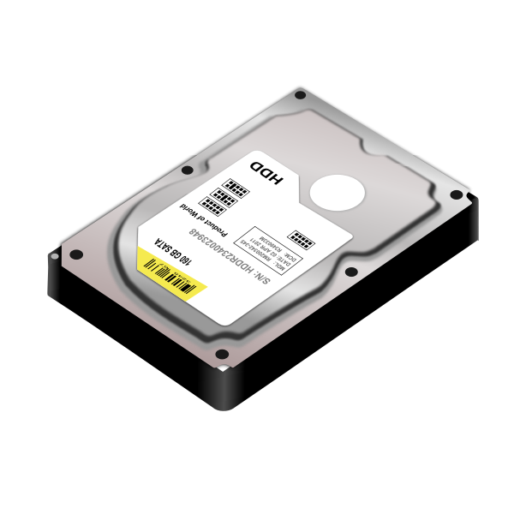
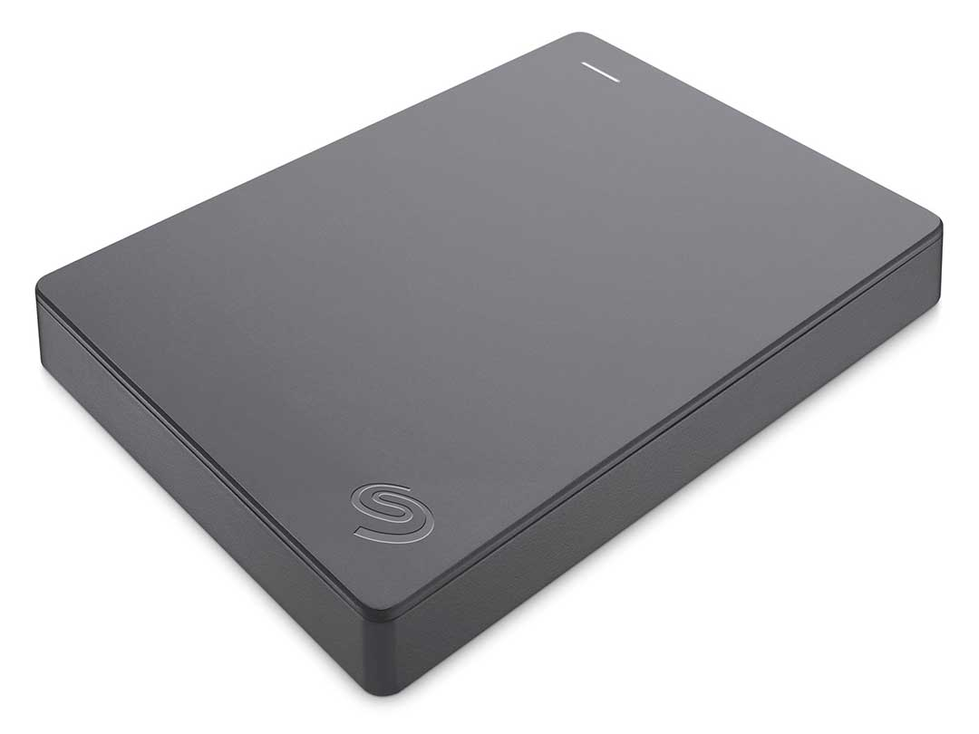
Memory Category

Slide 10
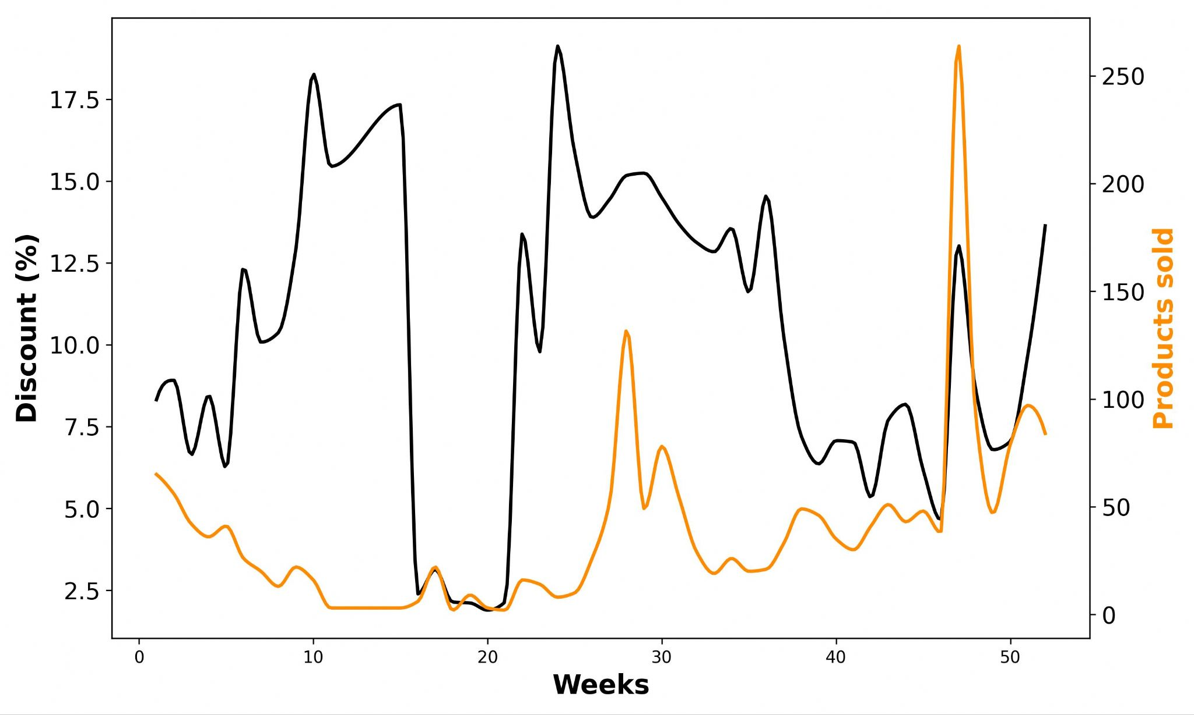
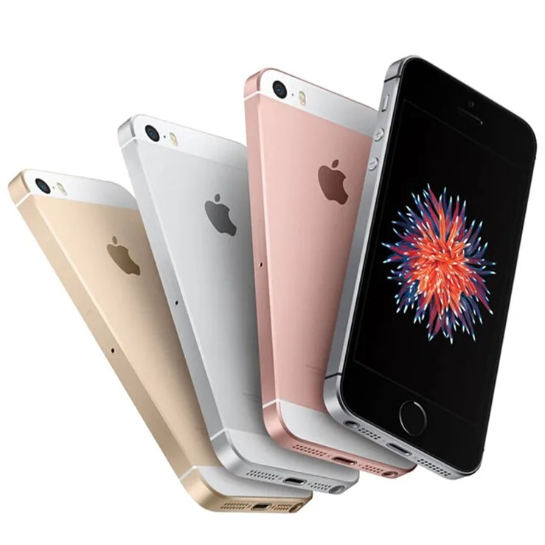
Smartphone Category

Slide 11
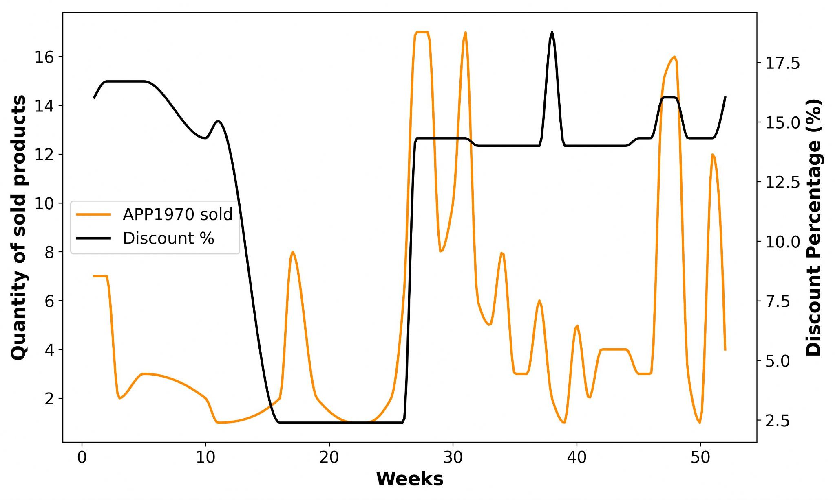
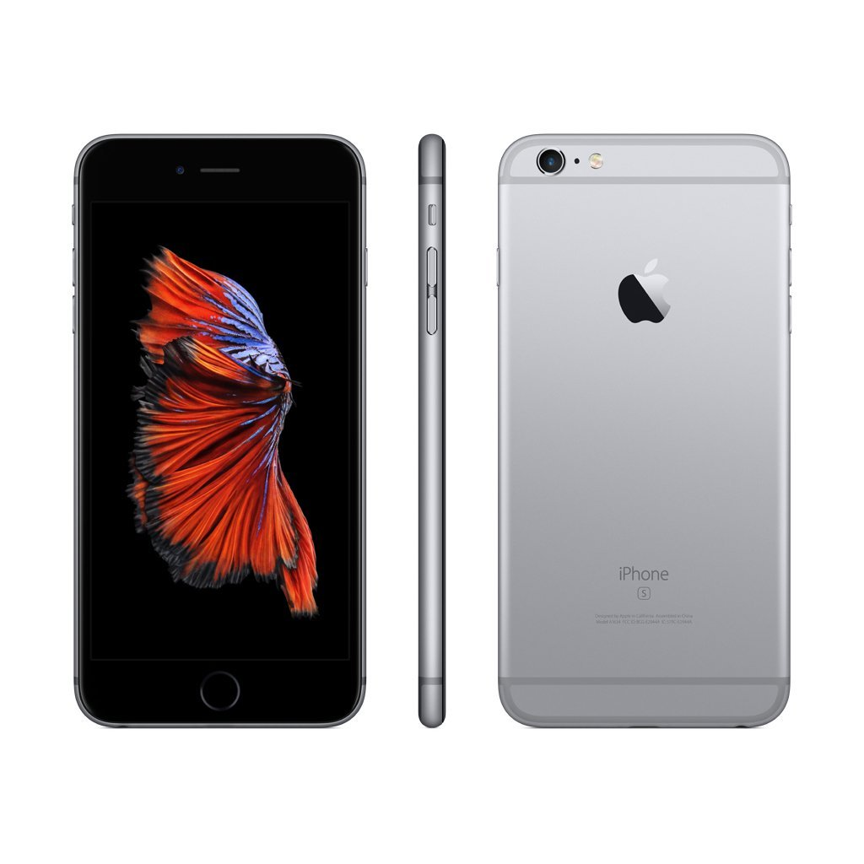
Looking at the best selling Smartphone
Apple iPhone 32GB Space Gray
No discount / sales correlation

Slide 12
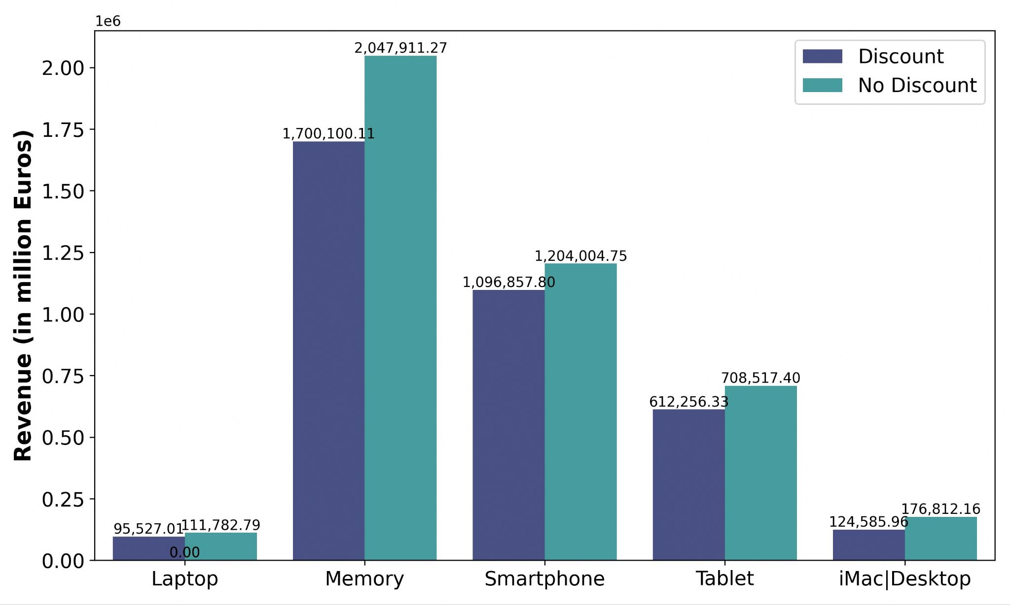
Revenue Perspectives
20 %
10 %
Potential revenue increases by tuning the Discount!
16 %
17 %
42 %

Slide 13
Conclusions and Recommendations
Data-collecting channel needs to be re-checked. Set standards regarding nomenclature, relativity and scope of the dataset.
Aggressive discounts don’t work!
Low to Mid discounts can increase sales & potentially better attract new customers.
Introduce New incentives: * Free Shipping * Bundle Offers (low- & top-selling products offered together at a discount)
Top-selling products sell regardless of discounts.
Focus on other Marketing tools, not discounts!

